Slide 1

Project Title –
SEASONAL AGRICULTURE PERFOMANCE ANALYSIS
Student Name –
FAZHAN P
College Name-
SAINTGITS COLLEGE OF ENGINEERING
AICTE STU ID : STU6a6b799a9889e1785428378

Slide 2

PROBLEM STATEMENT
Agricultural activities are influenced by seasonal variations in environmental conditions, farming practices, resource availability and market conditions. As a result, agricultural performance may differ from one season to another. However, raw agricultural data does not clearly explain how agricultural performance changes across seasons or what patterns can be observed in different seasonal conditions. The problem is to analyze the given agricultural dataset and investigate seasonal differences in agricultural performance by identifying meaningful patterns, trends, relationships and variations within the available data.

Slide 3
Project Description
This project performs an end-to-end data analytics study of agricultural activities across different seasons.
The dataset contains information related to:
Geographical factors – State and District
Agricultural factors – Crop and Farm Area
Environmental conditions – Rainfall, Temperature, Humidity and Sunlight
Soil conditions – Soil pH and Soil Moisture
Resource usage – Fertilizer, Pesticide, Irrigation and Water
Production – Yield and Total Production
Economic performance – Cost, Revenue, Market Price and Profit
Risk factors – Disease and Pest Risk
The analysis compares Kharif, Rabi and Zaid seasons to identify patterns affecting agricultural productivity, resource efficiency and profitability.
Dataset Summary
4,000 records | 28 variables | 3 seasons | 8 crops | 8 states

Slide 4

WHO ARE THE END USERS?
1. Farmers
Select suitable crops and seasons
Improve resource utilization
Identify profitable farming practices
2. Agricultural Planners
Support seasonal agricultural planning
Compare regional performance
Identify areas requiring intervention
3. Government & Agricultural Departments
Develop evidence-based agricultural policies
Monitor seasonal productivity
Plan resource allocation
4. Agribusiness & Market Stakeholders
Understand production and market trends
Assess seasonal profitability
5. Data Analysts & Researchers
Study relationships between environmental factors and agricultural performance
Develop predictive agricultural models

Slide 5

Technology Used
Programming Language
Python
Development Environment
Google Colab
Jupyter Notebook
Libraries
Pandas – Data manipulation and analysis
NumPy – Numerical computation
Matplotlib – Data visualization
Seaborn – Statistical visualization
SciPy – Statistical testing
Scikit-learn – Machine learning
Analysis Techniques
Exploratory Data Analysis
Descriptive Statistics
Correlation Analysis
Seasonal Comparison
ANOVA / Kruskal-Wallis Test
Random Forest Regression
Dataset
CSV format
4,000 agricultural records
28 variables

Slide 6
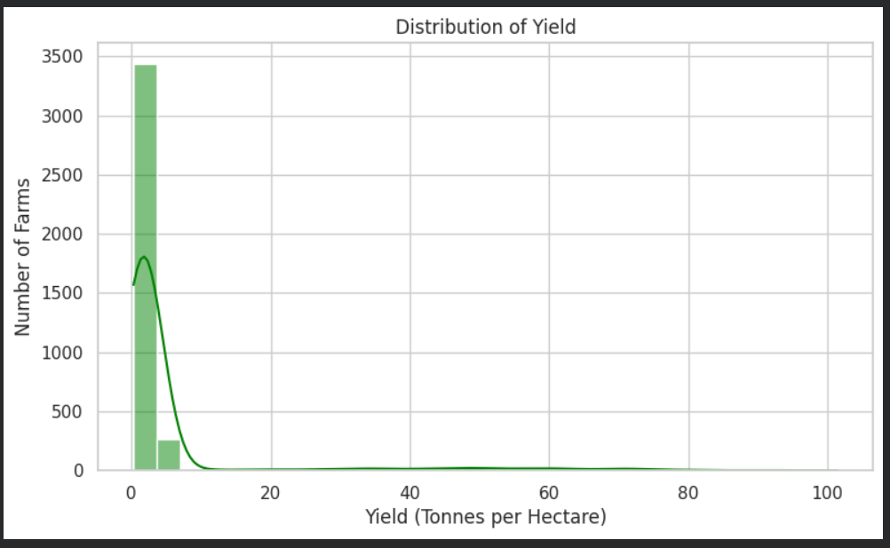
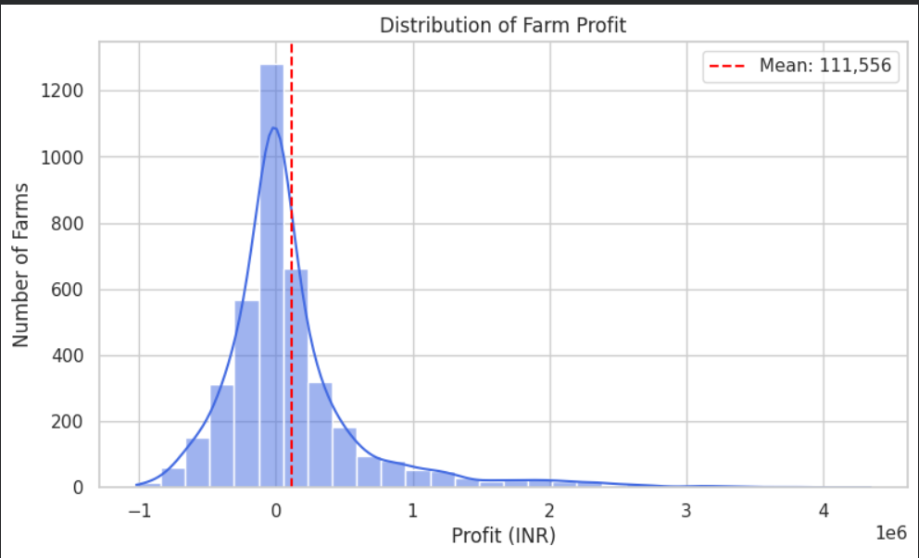
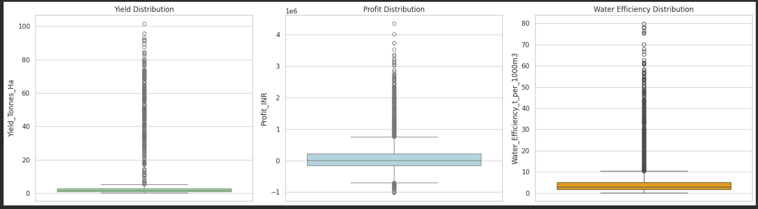
RESULTS

Slide 7
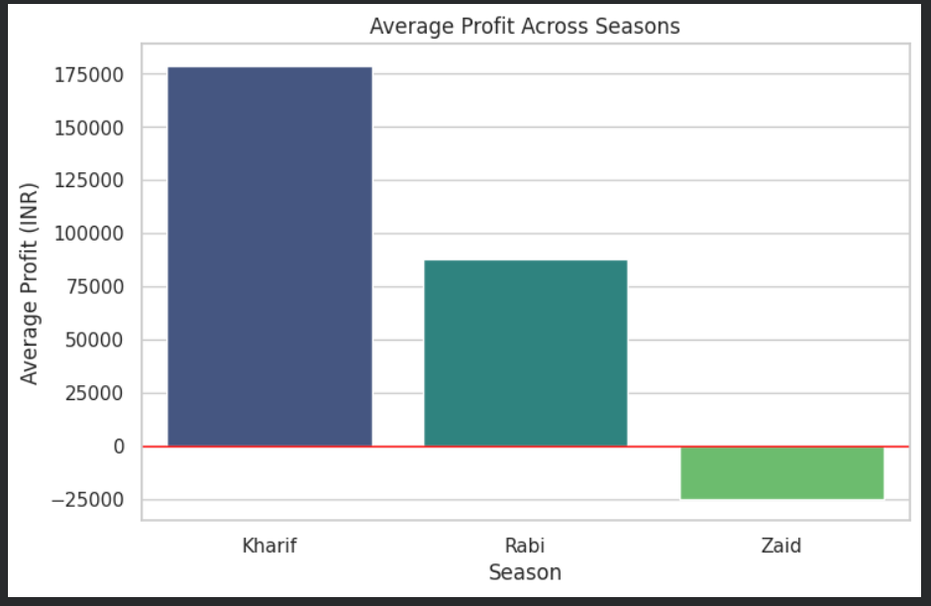
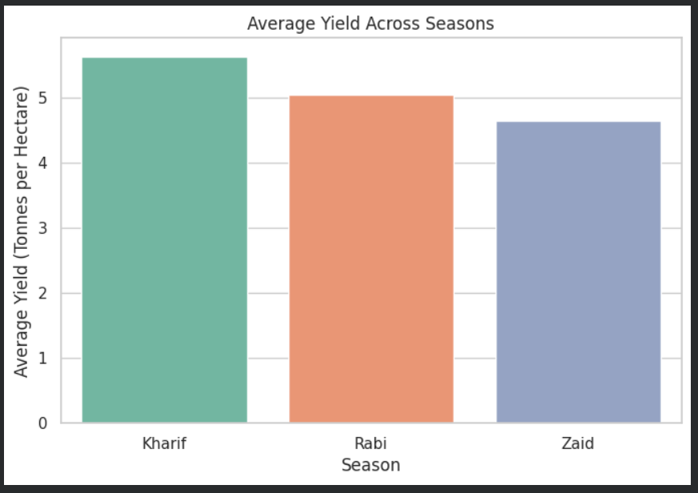
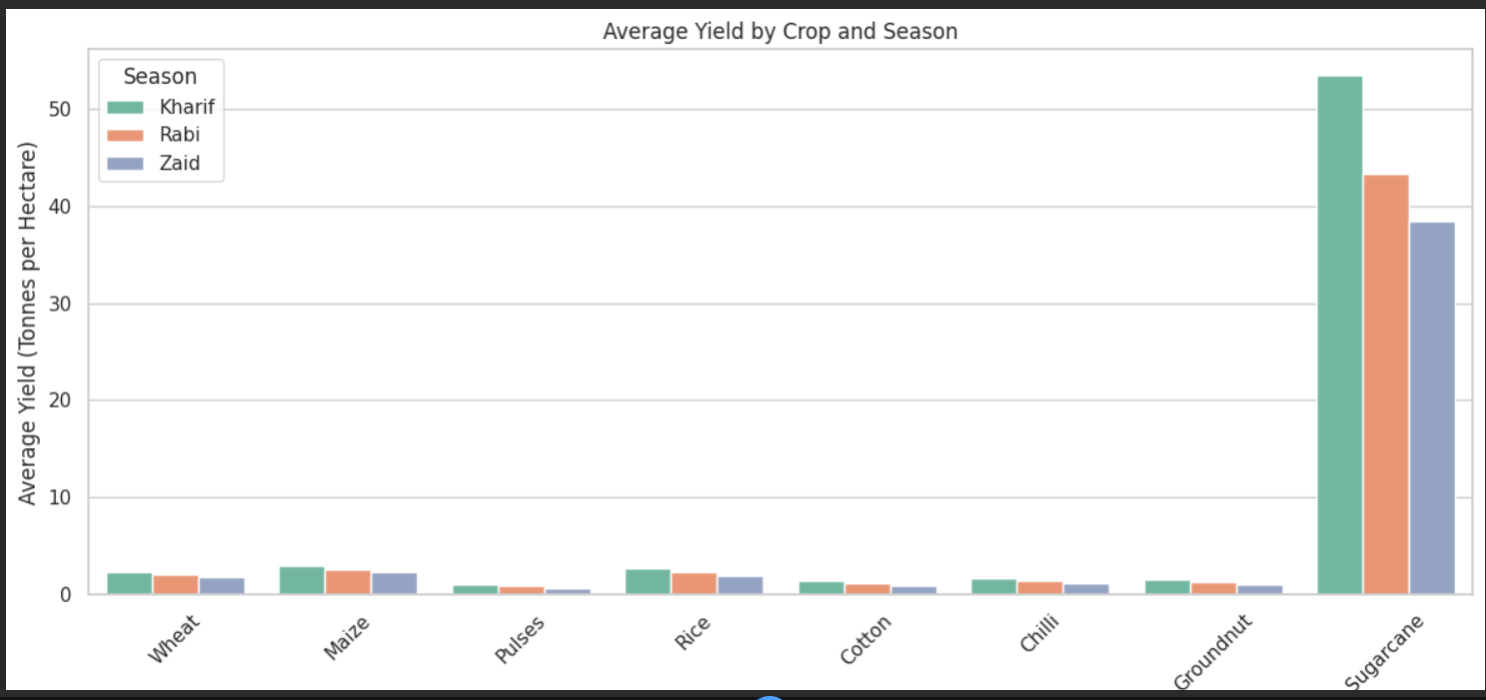
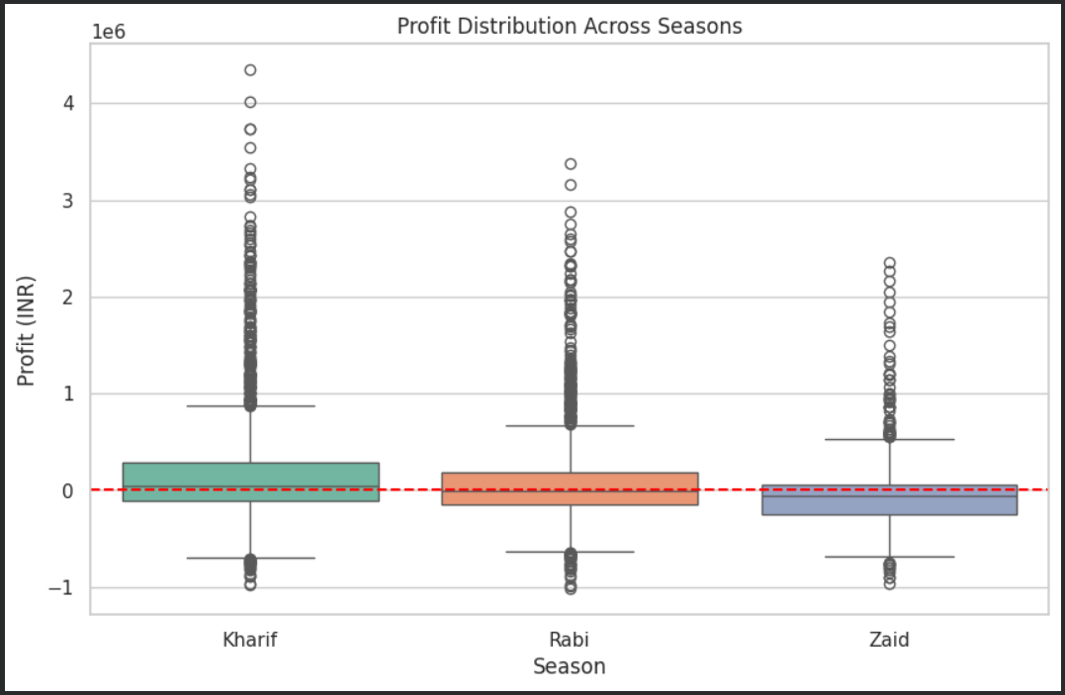
RESULTS

Slide 8
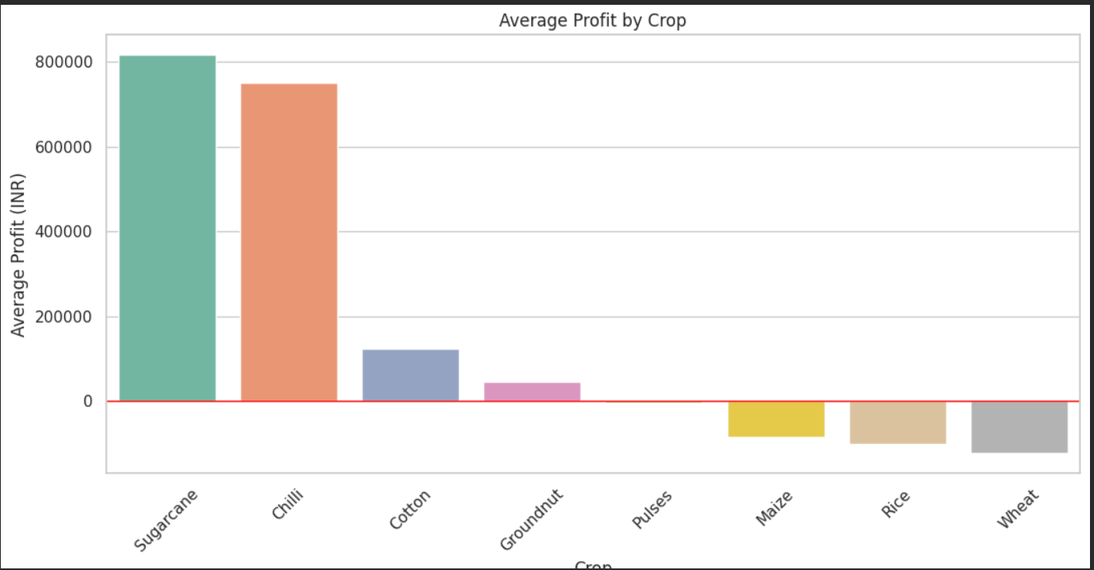
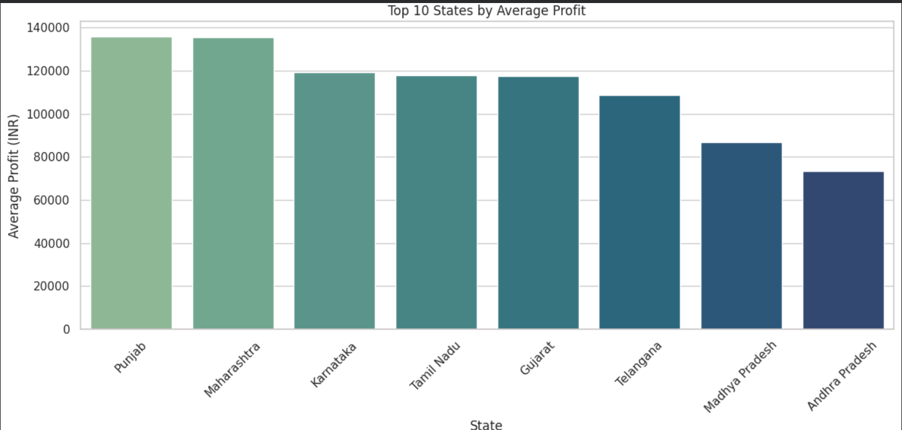
RESULTS

Slide 9
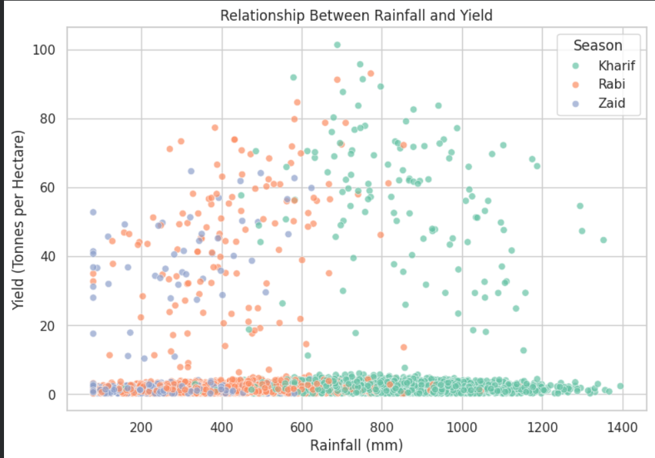
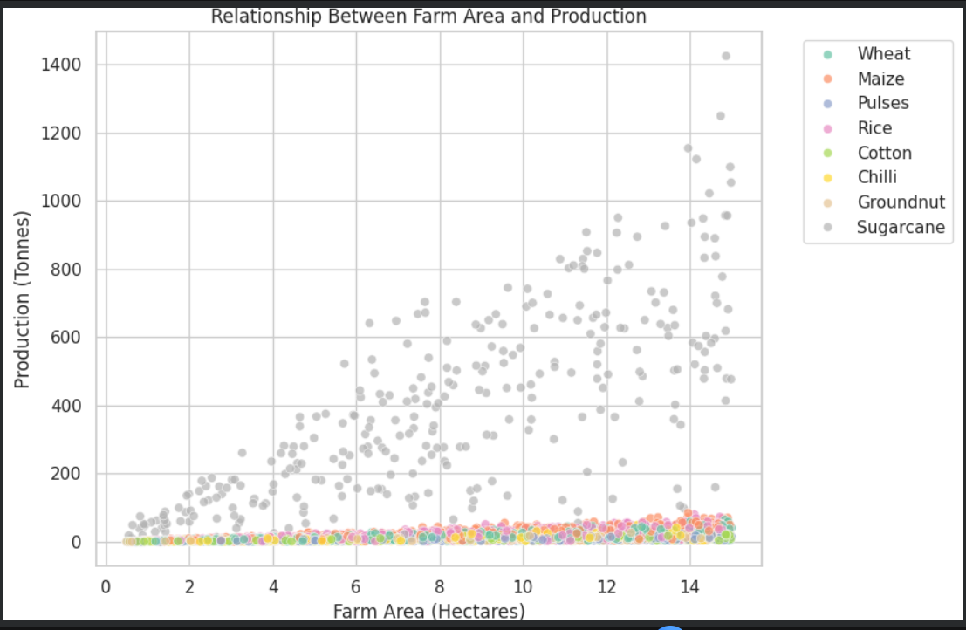
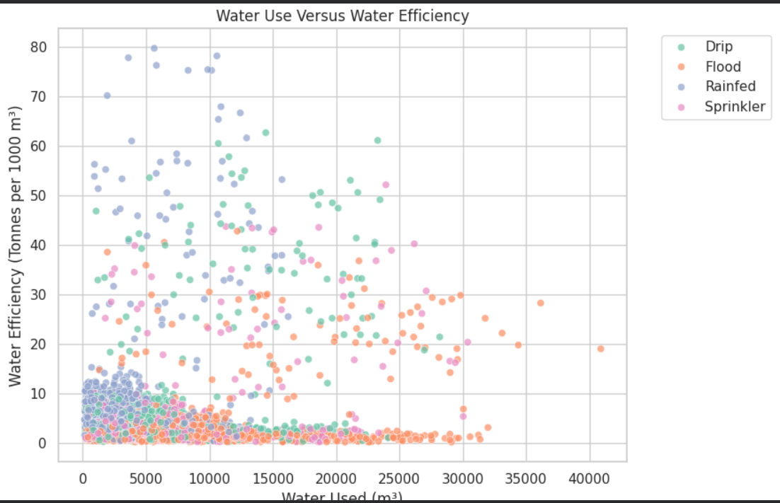
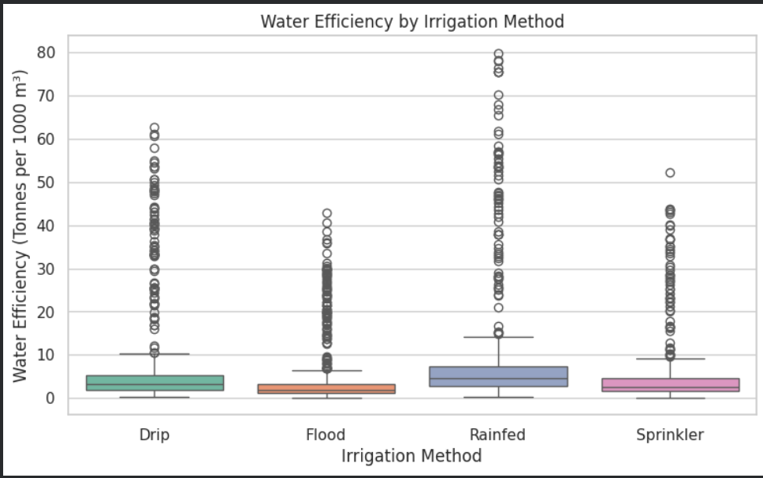
RESULTS

Slide 10
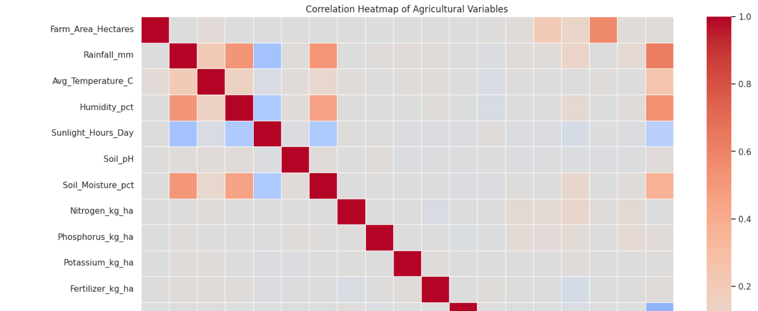
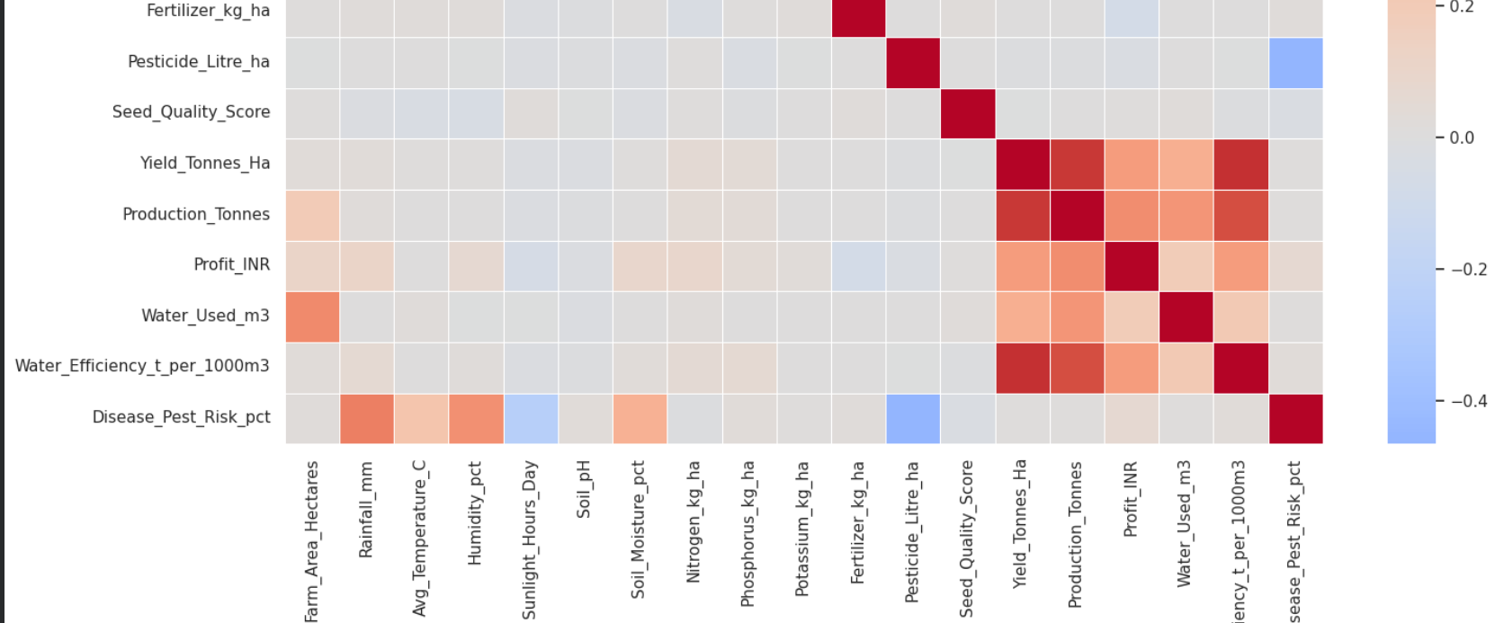
RESULTS

Slide 11
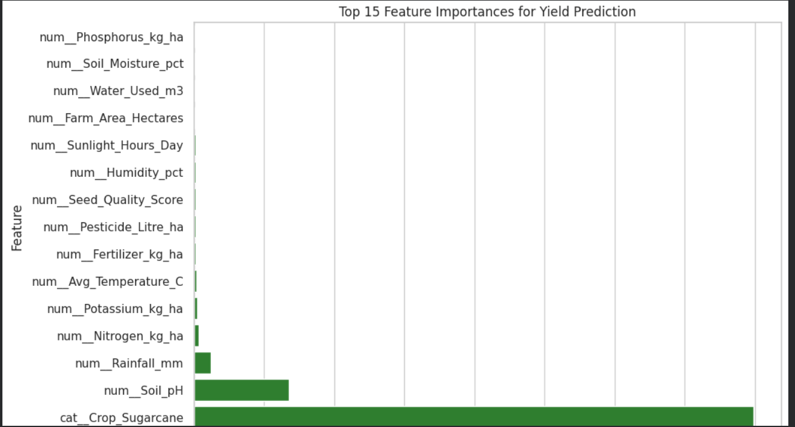
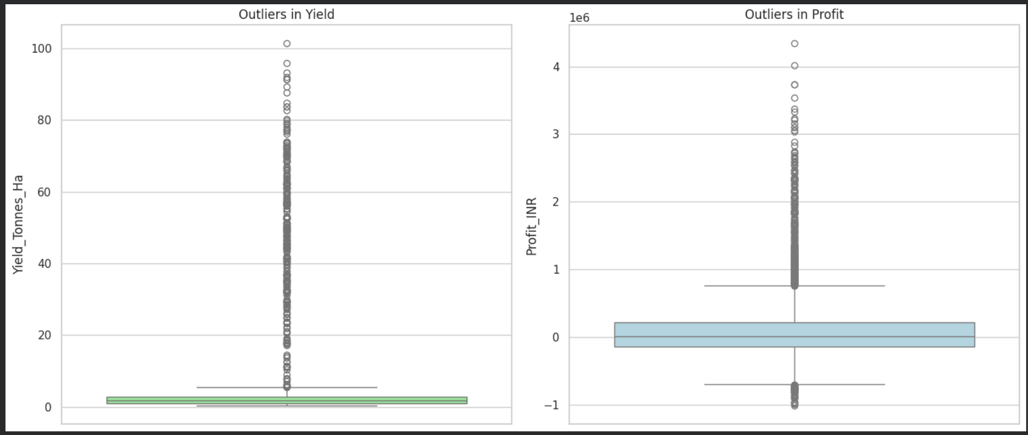
RESULTS

Slide 12
Future scope
The project can be extended in the following ways:
Predictive Yield Modeling
  Predict crop yield using environmental and farming variables.
Crop Recommendation System
  Recommend suitable crops based on season, soil and climate conditions.
Profit Prediction
  Predict expected revenue, cost and profit before cultivation.
Weather Integration
  Integrate real-time and historical weather information.
Smart Irrigation
  Develop models to optimize irrigation and reduce water consumption.
Disease Prediction
  Predict disease/pest risk using environmental conditions.
Geographical Analysis
  Develop district/state-level agricultural performance maps.
Time-Series Analysis
  Analyze agricultural performance across multiple years.

Slide 13
GitHub Link
https://github.com/Fazhanp/Seasonal-Agriculture-Perfomance-Analysis.git

Slide 14
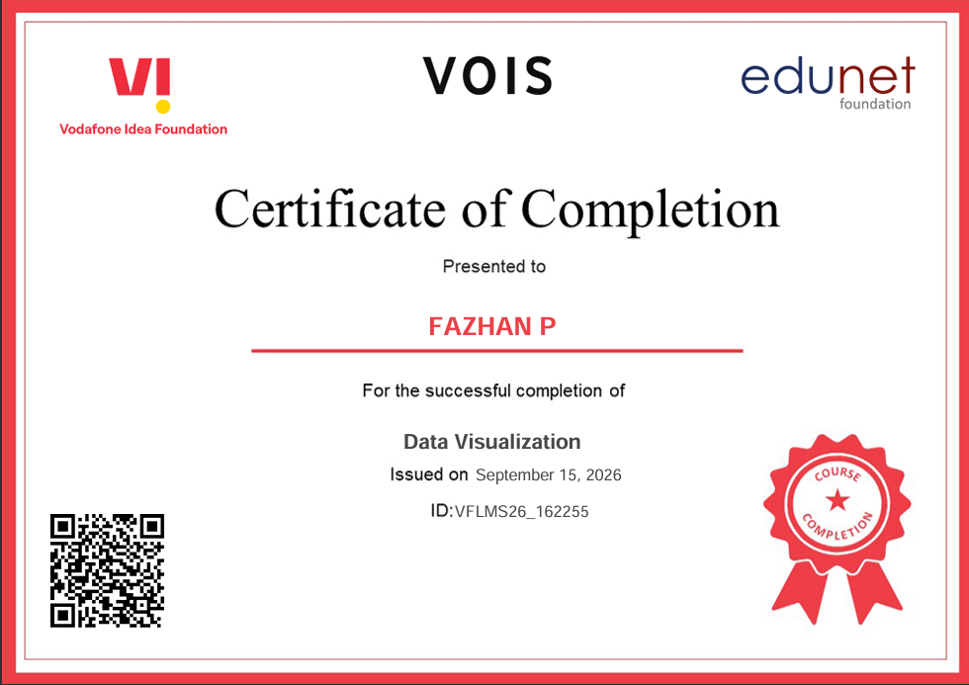
VOIS Course completion certificate -
Course name- Data Visualization

Slide 15
Thank you
Student Name –
FAZHAN P
College Name-
SAINTGITS COLLEGE OF ENGINEERING
.
.

